Slide 1
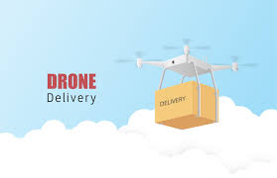
Medical Delivery Drone
HARISH. G
3RD YEAR CSE

Slide 2
ABSTRACT
The use of medical delivery drones has been recognized as a promising technology to enhance healthcare availability and delivery in challenging and inaccessible regions.
The delivery drones can overcome geographical barriers, allowing for the prompt and efficient transportation of important medical supplies such as vaccines, medications, and blood samples.
Furthermore, medical delivery drone has the potential to decrease the risk of human exposure to infectious diseases and enhance responsiveness during critical situations.
Nevertheless, there are several regulatory, technological, and organizational hurdles that must be overcome to guarantee the secure and dependable operation of drone medical delivery.
Despite these challenges, the future of healthcare delivery may be revolutionized by drone medical delivery, leading to better patient outcomes.

Slide 3
EXISTING SYSTEM
Over the past decade, there has been a growing interest in the use of drones for medical delivery. Numerous researchers, organizations, and companies have developed and tested drone technologies for medical delivery in various parts of the world. Some notable examples of medical delivery drone technologies include:
Zipline: This US-based company has developed a fleet of medical delivery drones that are currently being used in Rwanda, Ghana, and other countries to deliver blood and medical supplies to remote areas.
Matternet: This Switzerland-based company has developed a drone-based logistics platform for medical delivery, which has been used in various pilot projects around the world, including in Switzerland and the United States.
Vayu: This India-based company has developed a medical delivery drone that can transport medical supplies and samples to remote areas with limited infrastructure.
Swoop Aero: This Australian-based company has developed a drone-based medical delivery system that has been used in various pilot projects in Africa, Australia, and the Asia-Pacific region.

Slide 4
INTRODUCTION
Drone medical delivery, also known as medical drone delivery, is an emerging technology that has the potential to transform healthcare delivery. With its ability to navigate through remote and hard-to-reach areas, drone medical delivery can provide essential medical supplies to patients who might otherwise lack access to healthcare services. This technology has the potential to revolutionize healthcare delivery in areas with poor infrastructure, limited transportation options, and challenging terrain.
The use of drones for medical delivery can provide numerous benefits. For instance, drone delivery can provide timely and efficient transportation of medical supplies, such as vaccines, medications, and blood samples, especially in emergencies. Drones can also minimize the risk of human exposure to infectious diseases and reduce the time taken for healthcare professionals to travel to remote areas. This means that patients in these areas can receive medical supplies and attention in a timely manner, improving their chances of recovery and overall health outcomes.
However, there are several challenges that need to be addressed for the successful implementation of drone medical delivery. These include regulatory, technological, and logistical issues. For instance, regulations must be put in place to ensure the safe and responsible use of drones. Technologically, drones must be capable of navigating through challenging terrain and weather conditions, while also ensuring the safety of medical supplies during transportation. Logistically, systems must be in place to manage the logistics of drone delivery, including the coordination of deliveries and the tracking of medical supplies.
Despite these challenges, drone medical delivery has the potential to revolutionize healthcare delivery and improve patient outcomes. As such, governments and organizations around the world are investing in this technology as a means of improving healthcare access and delivery.

Slide 5
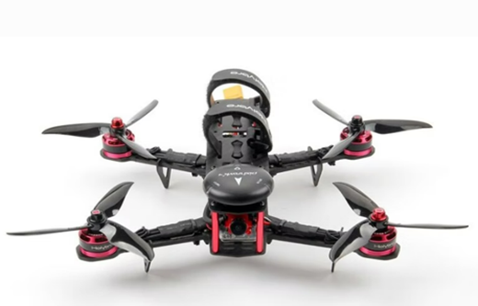
PROPOSED SYSTEM
Here we have used the two drone technologies such as the normal drone and FPV drone for better drone technologies which will open more wider opportunities to create and explore by doing this we can achieve lot of applications. The APM2.8 flight controller is a popular open-source flight controller that is widely used in the drone industry. When combined with a QA250 frame, it provides an excellent platform for building a small, high-performance drone.
The APM2.8 flight controller is a multi-purpose control system that is designed to control drones, planes, and other autonomous vehicles. It is based on the Arduino platform and uses a combination of sensors, GPS, and other components to provide stable and accurate flight control. The APM2.8 flight controller has a range of features that make it an excellent choice for building a drone with a QA250 frame.
Accelerometers and Gyros: The APM2.8 flight controller includes three-axis accelerometers and three-axis gyros, which provide precise measurements of the drone's movement and orientation.
GPS: The APM2.8 flight controller also includes a GPS module, which provides accurate positioning information that can be used for navigation and other purposes.

Slide 6
Barometer: The APM2.8 flight controller includes a barometer, which provides information on the drone's altitude.
Compass: The APM2.8 flight controller includes a digital compass, which provides information on the drone's orientation.
When combined with a QA250 frame, the APM2.8 flight controller provides a stable and responsive platform for flying small drones. The QA250 frame is a lightweight and durable frame that is designed for small drones. It is made from high-quality materials, such as carbon fiber and aluminum, and is designed to be easy to assemble and customize.
To use the APM2.8 flight controller with a QA250 frame, you will need to connect the flight controller to the frame and configure it using a computer. The APM2.8 flight controller comes with software that can be installed on a computer, which allows you to configure the flight controller's settings and set up your drone.
Once the flight controller is connected and configured, you can start flying your drone. The APM2.8 flight controller provides a range of flight modes, including manual mode, stabilized mode, and automatic mode. In manual mode, you have full control over the drone's movement and orientation. In stabilized mode, the flight controller uses its sensors to stabilize the drone and make it easier to fly. In automatic mode, the drone can fly autonomously, following pre-programmed flight paths and waypoints.

Slide 7
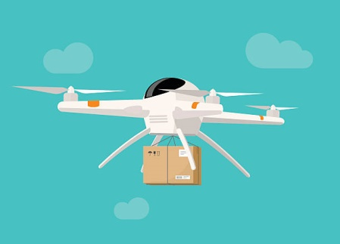
This drone is consisting of various technologies in it which can be widely used in all sectors. This drone is consisting of obstacle avoidance and FPV system which make more reliable to fly and discover more.
This drone inheritance of various features and have better
It provides accurate and stable flight control, and its open-source nature allows for easy customization and integration with other components. By combining the APM2.8 flight controller with a QA250 frame, you can build a high-performance drone that is ideal for a range of applications, from aerial photography to search and rescue.
Endurance.
Traffic and Obstacle Detection.
Navigation.
Communication.

Slide 8
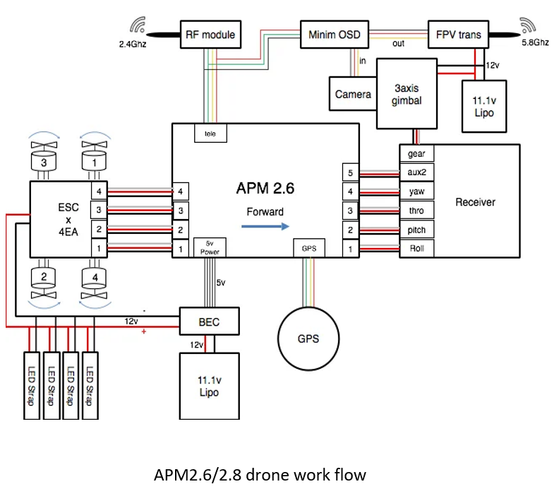
SYSTEM ARCHITECTURE

Slide 9
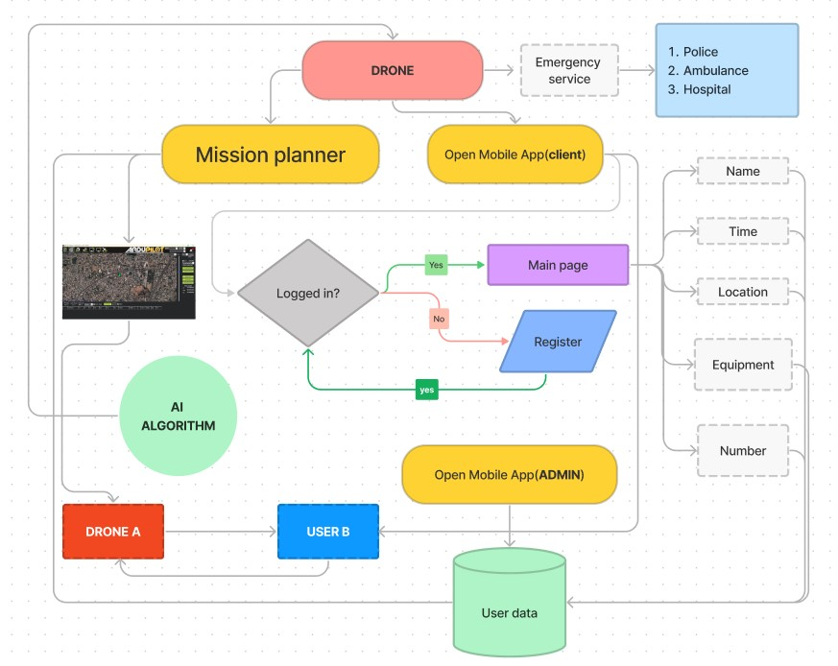
USER FLOW DIGRAM

Slide 10
RESULTS AND CONCLUSION
The execution of the process have been successfully executed which implies the various model of phases which include the multiple criteria’s under which it has been executed. This drone basically consists of the very light weight material for the maximum portability and can carry up to the max weight of 1.5kg which opens the various opportunities to create.
Delivering of medical supplies to the remote areas
Speedy recovery of patients
Easy access to emergency medical resources and delivering medical supplies to disaster zones , remote areas .
It tracks the location of the user and deliveries the needed medical resources.
Long lasting and carries maximum of 1.2 to 1.5 kilograms .
It can detect traffic and obstacles and overcome it so that the products are delivered on time and easily to the user/patients.
The maximum flight time and the maximum rage of this drone is 20 mins and 5km respectively. This drone includes the 32bit processor for its very fast response to the real world scenarios and can perform the obstacle avoidance.

Slide 11
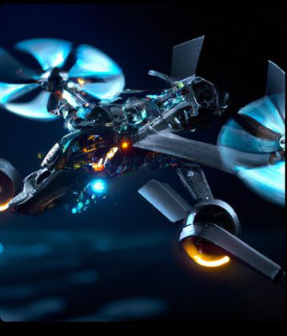
RESULTS :

Slide 12
REFERENCES
"Interior Mapping with Drones: A Review" by Mohamed Elhelw and Hassan A. Karima.
"The Future of Interior Mapping: How Drones are Revolutionizing the Industry" by David Newbry.
"A Guide to Interior Drone Mapping: Techniques and Applications" by Ahmed Boussakta.
"Interior Mapping with Drones: Challenges and Solutions" by Brian Benchoff.
"How Drone Technology is Changing Interior Mapping" by Adam Stone.
"Indoor Drone Mapping: Benefits and Limitations" by Alex Banks.
"The Use of Drones for Accurate Interior Mapping" by Emre Ozan Alp.
"Interior Drone Mapping for Surveying and Inspections" by Michael Karpeles.
"An Introduction to Interior Drone Mapping: Techniques and Equipment" by Fred Lambert.
"The Potential of Interior Drone Mapping for Building Information Modelling" by Caroline Hayes

Slide 13
THANK YOU

